Slide 1
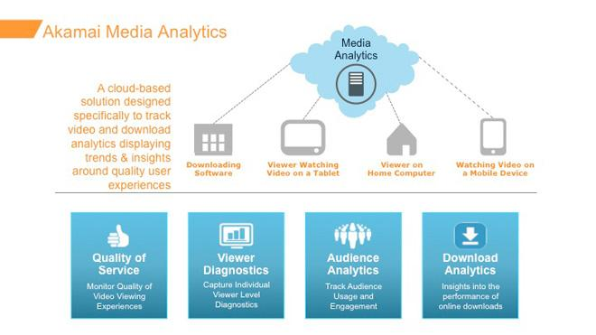
Media Analytics

Slide 2
Audience Analytics - KPIs
Audience Analytics:
Audience Analytics is a behavioral analysis module
Understanding how content, packaging, and quality are impacting the business
Metrics:
Audience Engagement: Viewers, Visits, Plays, Play Duration, Play Percentage, Completion Rate, Plays Abandoned Audience Analytics - The Business Summary Dashboard
Quality: Play Attempts, Video Startup Time, Video Availability, Average Bitrate, Rebuffering, Dropped Frames, Errors, Connection Speed
Dimension:
Standard: Geography, Device, Connection Speed, ISP, Video Title, Video Length, Content Category, Player Domain, Referrer URL, Error Code

Slide 3
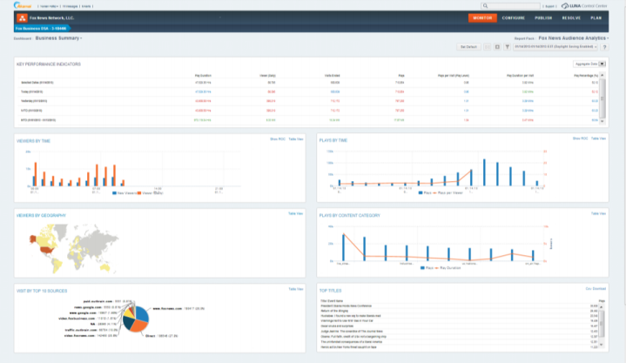
DashBoard – Audiences
Audience size: là Total user truy cập của 1 CDN or Khách hàng (nhiều CDN)
CDN availablity: là PING vào 1 EDGE nào đó or RR
Connection Speed: là tốc độ trung bình download của CDN / Khách hàng (nhiều CDN)
Bit-Rate: là tốc độ DL trung bình của Player khi play video
Start-up delay: Là khoảng delay time trước khi play video
# Video Plays
Play Duration
Play Conversion Rate
Key Performance Indicators
Total minutes
Avg View time
Player Impression
Video Conversion rate
Content Categories:
- Films; Kids; Shows…
Viewer by TIME
Play by Time
Viewer by Geography
Play by Content Category
Visit by Top 10 Countries
Top Titles

Slide 4
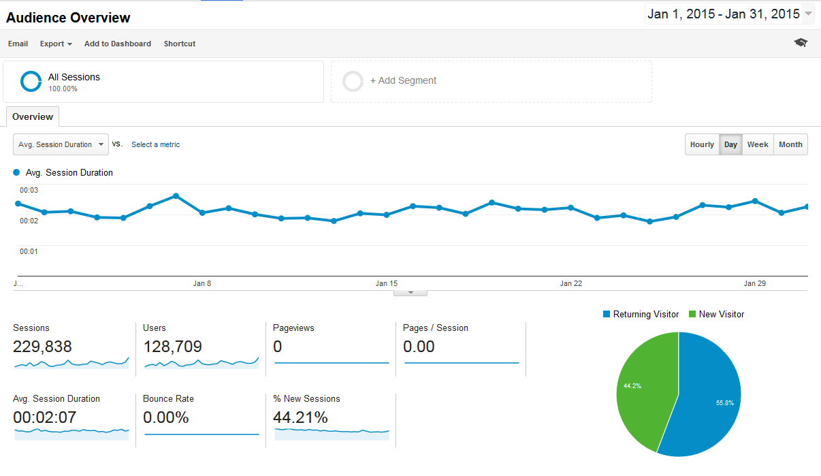
DashBoard – Audiences
Audience size: là Total user truy cập của 1 CDN or Khách hàng (nhiều CDN)
CDN availablity: là PING vào 1 EDGE nào đó or RR
Connection Speed: là tốc độ trung bình download của CDN / Khách hàng (nhiều CDN)
Bit-Rate: là tốc độ DL trung bình của Player khi play video
Start-up delay: Là khoảng delay time trước khi play video
Player Impression
Play #
Play by Time
Viewer by TIME
Visit by Top 10 Countries
Top Titles

Slide 5
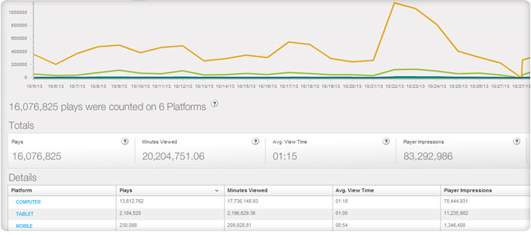
DashBoard – Content Analytics
Audience size: là Total user truy cập của 1 CDN or Khách hàng (nhiều CDN)
CDN availablity: là PING vào 1 EDGE nào đó or RR
Connection Speed: là tốc độ trung bình download của CDN / Khách hàng (nhiều CDN)
Bit-Rate: là tốc độ DL trung bình của Player khi play video
Start-up delay: Là khoảng delay time trước khi play video
# Play over Time per Platform (Android)
Avg Viewed Time
Player Impression
Viewer by TIME
Categories

Slide 6
QoS Analytics - KPIs
QoS Monitoring:
Monitoring Media streaming in real time, Refreshes every 30 seconds
Show audience’s experience, including availability, start up time, re-buffering, and bitrate delivered
Support filtered across key dimensions, such as geography, ISP, and video format, for monitoring and problem isolation
Support send notification when issues are detected
Metrics:
Quality metrics: audience size, rebuffering ratio, startup time, successful attempts, and average encoded bitrate
Data Aggregate: from 30 seconds, up to 2 hours
Filter metrics: ISP, City, Country, Continent, Region, Format, Start Up Time Range, Error Code, Player ID, Connection Speed, Service Provider, Time, Title, or Category
Notification:
When conditions are met, notifications are raised to alert you to areas that require attention.
Thresholds are measured at the dimension level, so that ISP, city, or player-level localized problems are detected and reported accurately
Notifications are displayed in the UI, and via email and SMS

Slide 7
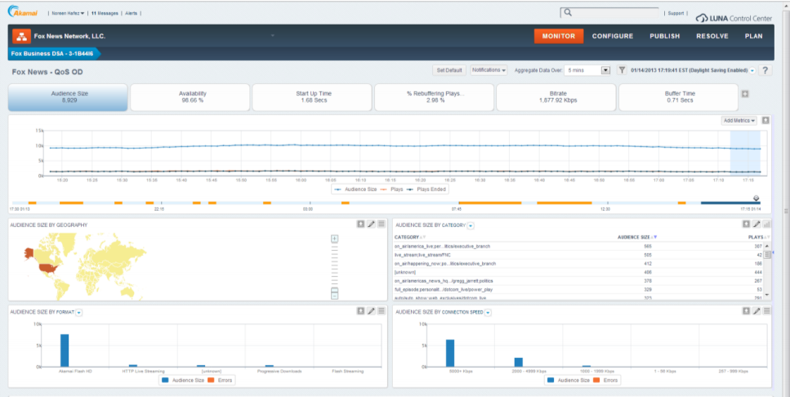
DashBoard – QoS
Audience size: là Total user truy cập của 1 CDN or Khách hàng (nhiều CDN)
CDN availablity: là PING vào 1 EDGE nào đó or RR
Connection Speed: là tốc độ trung bình download của CDN / Khách hàng (nhiều CDN)
Bit-Rate: là tốc độ DL trung bình của Player khi play video
Start-up delay: Là khoảng delay time trước khi play video
Audience Size
(number of user over the time)
CDN Availability
(over the time)
Start up Time
(Delay)
% Rebuffering Plays
Bit-rate
Buffer-Time
Audience size by Category
(number of User by topic and number of plays)
Audience size by Geography
Audience size by Format (Flash, HLS, MMS, DASH…)
Audience size by Connection Speed

Slide 8
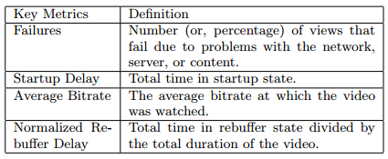
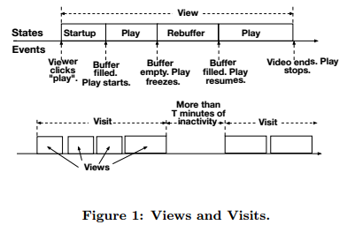
Definition
Start-Up Delay

Slide 9
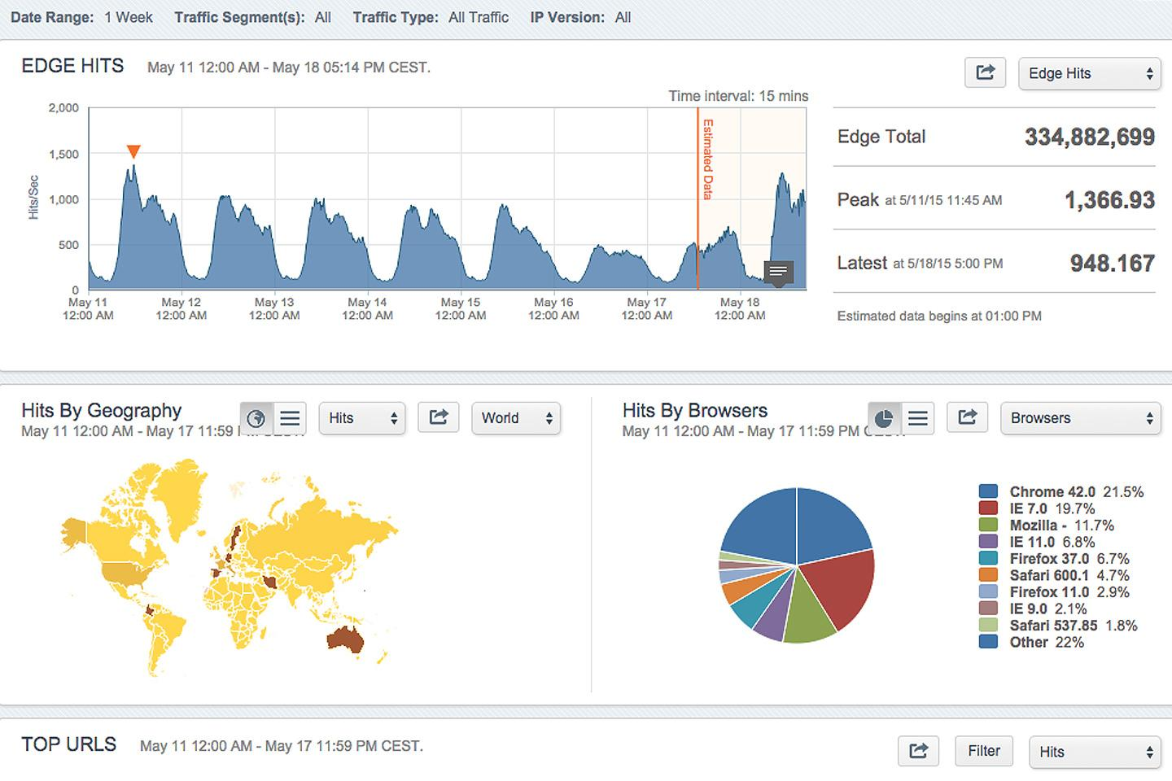
Per Customer – EDGE HIT

Slide 10
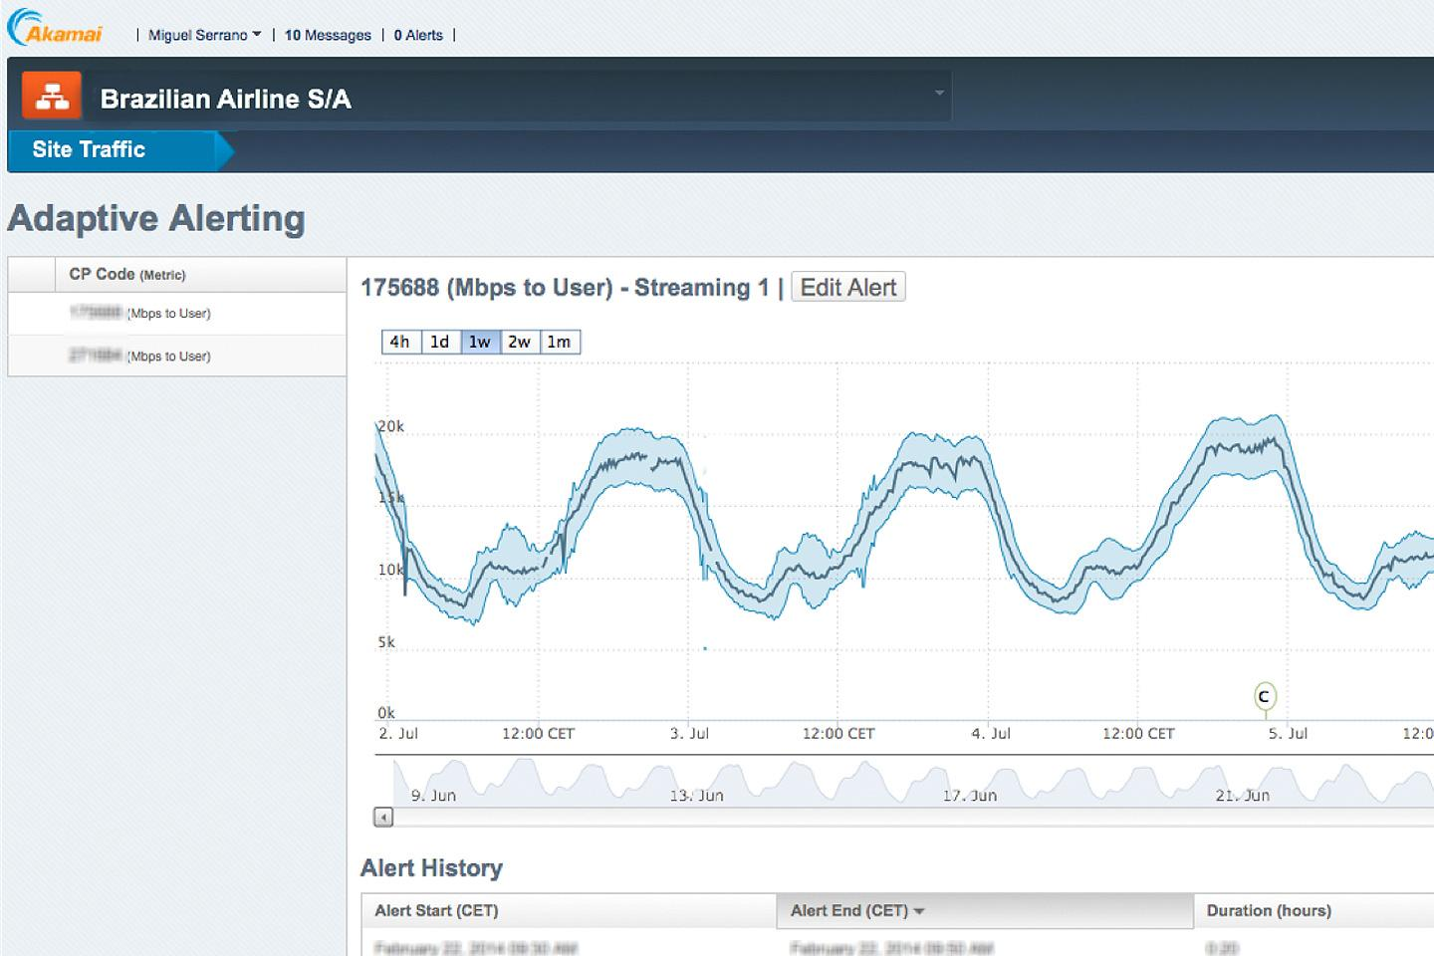
Per Customer Site Traffic

Slide 14
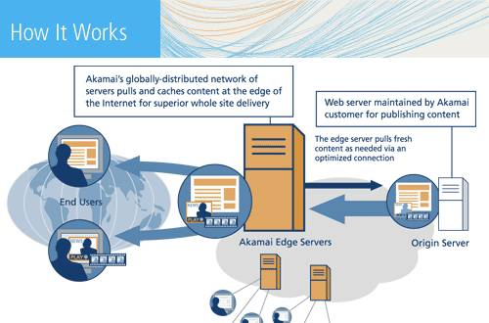

Slide 15
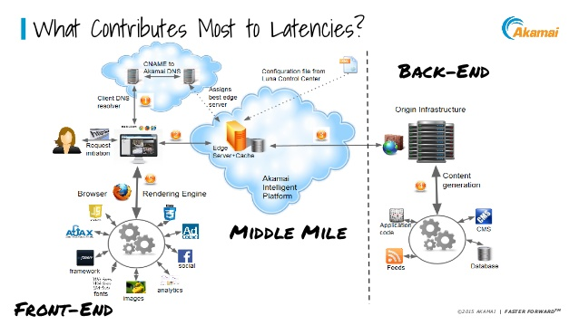

Slide 16
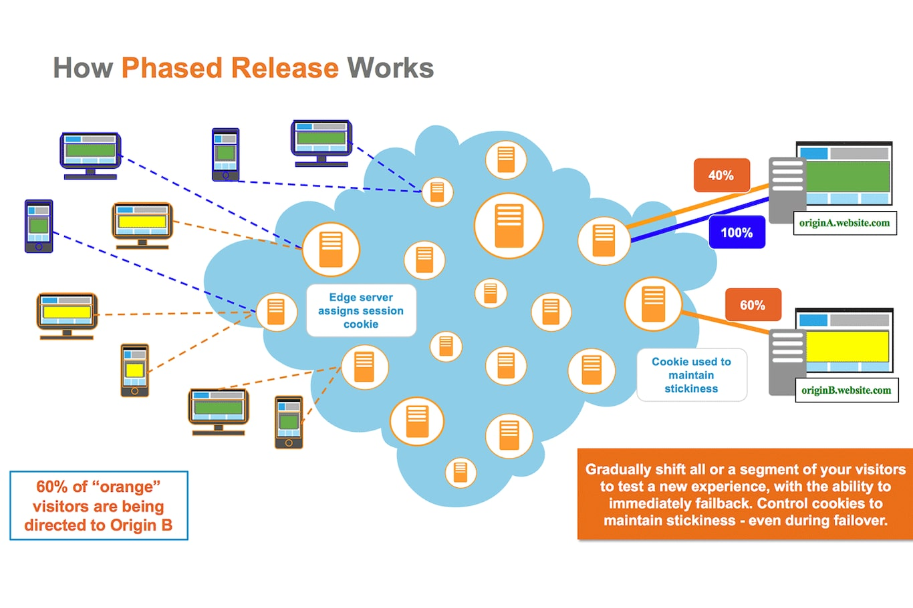

Slide 17
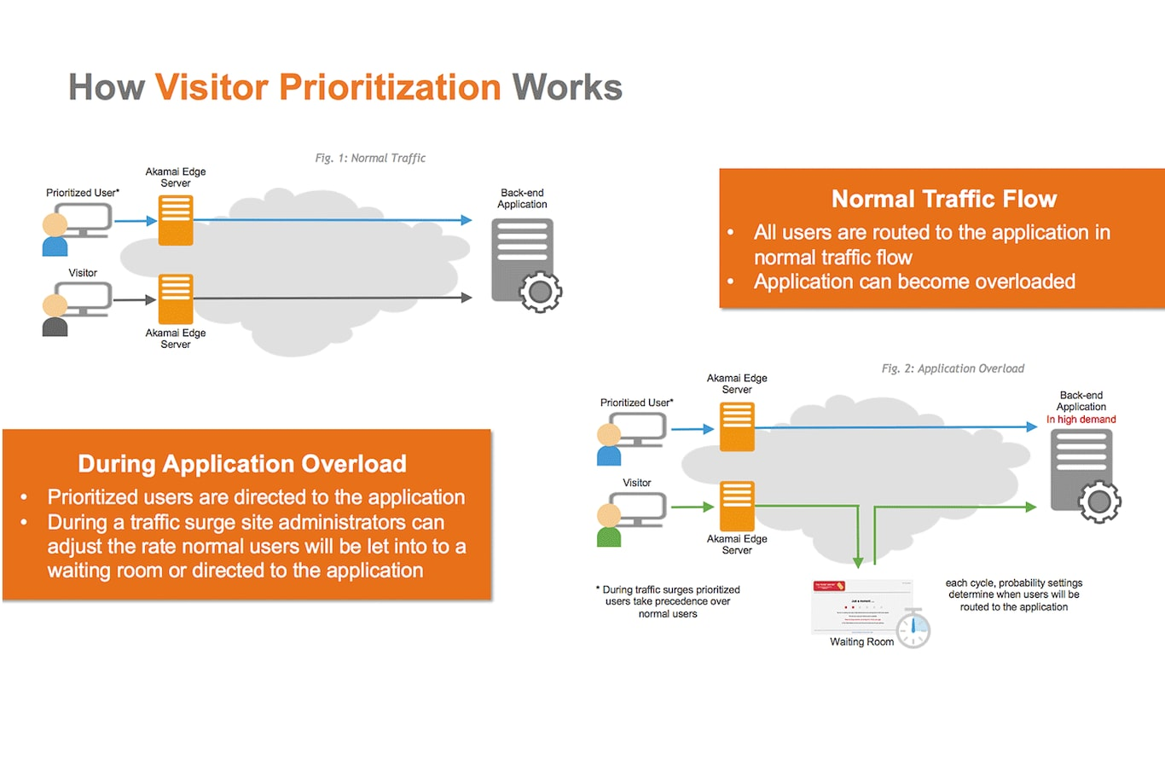

Slide 18


